Slide 1

Practical Web Development with
Spring boot
Project Summary
Presented by ARMS（THAILAND）Co., Ltd.

Slide 2
Project as a group
Practical Web Development with
Spring boot
Project summary
Each group has 5 members.
Each member has one task.
Choose one leader from the group

Slide 3
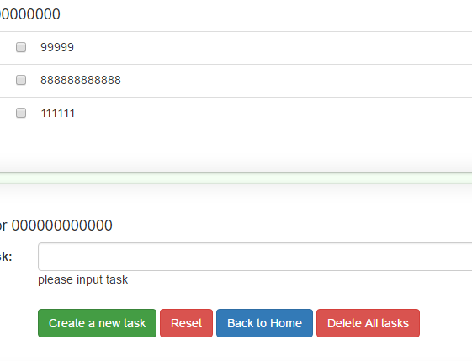
Validate task field on Indivilister
Practical Web Development with
Spring boot
Project summary
Validation message is up to you.
Redirect to the same page
Not allow to create empty task.

Slide 4
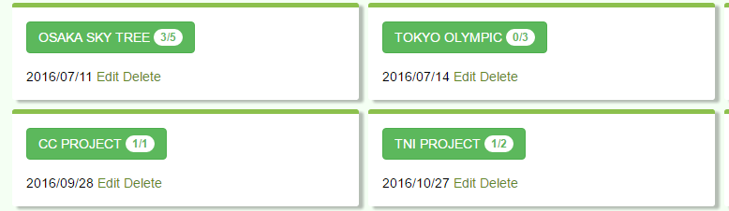
Display created date on Project
Practical Web Development with
Spring boot
Project summary
Display as 'yyyy/MM/dd‘ format
In Japan this date format is most common 'yyyy/MM/dd‘

Slide 5
Change the design of Indivilister
Practical Web Development with
Spring boot
Project summary
Not green color

Slide 6
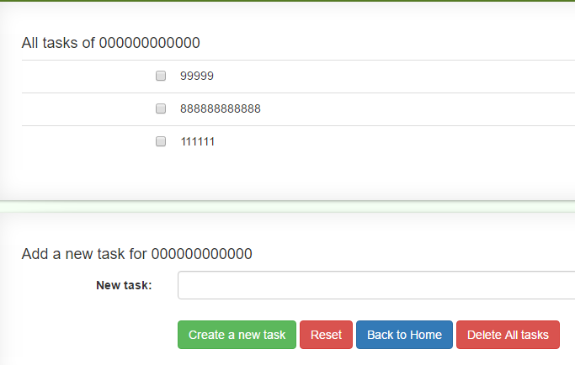
Create delete all tasks button
Practical Web Development with
Spring boot
Project summary
Hint
@Transactional

Slide 7
Leader’s task
Practical Web Development with
Spring boot
Project summary
Project management
Leader has to decide which member handles each task.
↓
Email to the teacher, who will take cake of each task
Send the project to the teacher.
If the project has an error, leader gets minus point
Check the project if it is working properly.
Leaders have to send at least twice to the teacher
1.When a team is created, and started the team project
2.When project is finished

Slide 8
% in grade
Practical Web Development with
Spring boot
Project summary
When student B missed task2
Leader 20%
Student A 25%
Student B 25%
Student C 25%
Student D 25%
Project 30%
Submit 10%
Leader
Task1 5% student A
Task2 5% student B
Task3 5% student C
Task4 5% student D
When leader didn’t submit Leader -5%
Student A 0%
Student B 0%
Student C 0%
Student D 0%
When student C,D missed task 3,4
leader 15%
Student A 20%
Student B 20%
Student C 20%
Student D 20%
Better work as a team and help with each other, leader should manage team members!!!

Slide 9
How to send your project
Practical Web Development with
Spring boot
Project summary
mikio.kakuyama@arms-asia.com
chaloemchai@arms-asia.com
The first email indivilister_ customized
[example]
email subject : KMUTNB TEAM NAME
leader name
team member name
The second email
indivilister_ customized
[example]
email subject : KMUTNB TEAM NAME
file: zip file

Slide 10

Your Idea Leads Your Ideals
homepage: http://arms-asia.com/
facebook: https://www.facebook.com/arms.asia?fref=ts

